Slide 1
Application For Collection Of Eye Specific Data
Guide:
Dr. K. Suvarna Vani
Team:
D.Sri Harsha (178W1A05C9)
N.Geethika (178W1A05D2) H.Sai Bhavana (178W1A05D6)
A.Prasanna (188W5A0525)

Slide 2
Abstract
Medical health systems have been concentrating on new techniques for speedy diagnosis. As the amount of image data in imaging centre of ophthalmology is increasing, analysing and processing these data is in need. The aim of this study is to develop a general User Interface for recording diagnostic data to facilitate auto-prediction of eye diseases. It is to ensure error-free data entry by developing a user - friendly interface. Furthermore, Machine Learning algorithms were used to analyse patient data based on multiple parameters and clinical observations. This data will be structured according to hierarchies designed by medical experts. Furthermore, the system is designed to evolve by adding new features and classifications for both symptoms and diagnosis. As many of individuals doesn’t care much about their vision for this reason, there is a need for a system thereby digitise the examination by capturing images of an eye on regular basis and to facilitate auto-prediction of eye diseases so there by redirecting to the corresponding specialised and localised doctors there by preventing the misdiagnosis upto some extent.
Key Words: vision problem, image acquisition, Machine learning, Artificial Intelligence, Intelligent data analysis.

Slide 3
Problem Statement
To design a prototype for the first stage rapid diagnosis of eye diseases by collecting the required information from the patient , Store them for future assessments to improvise conventional treatment methods for vision problems.

Slide 4
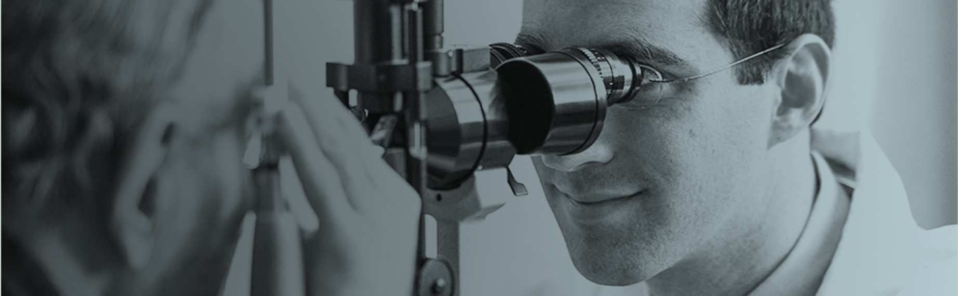
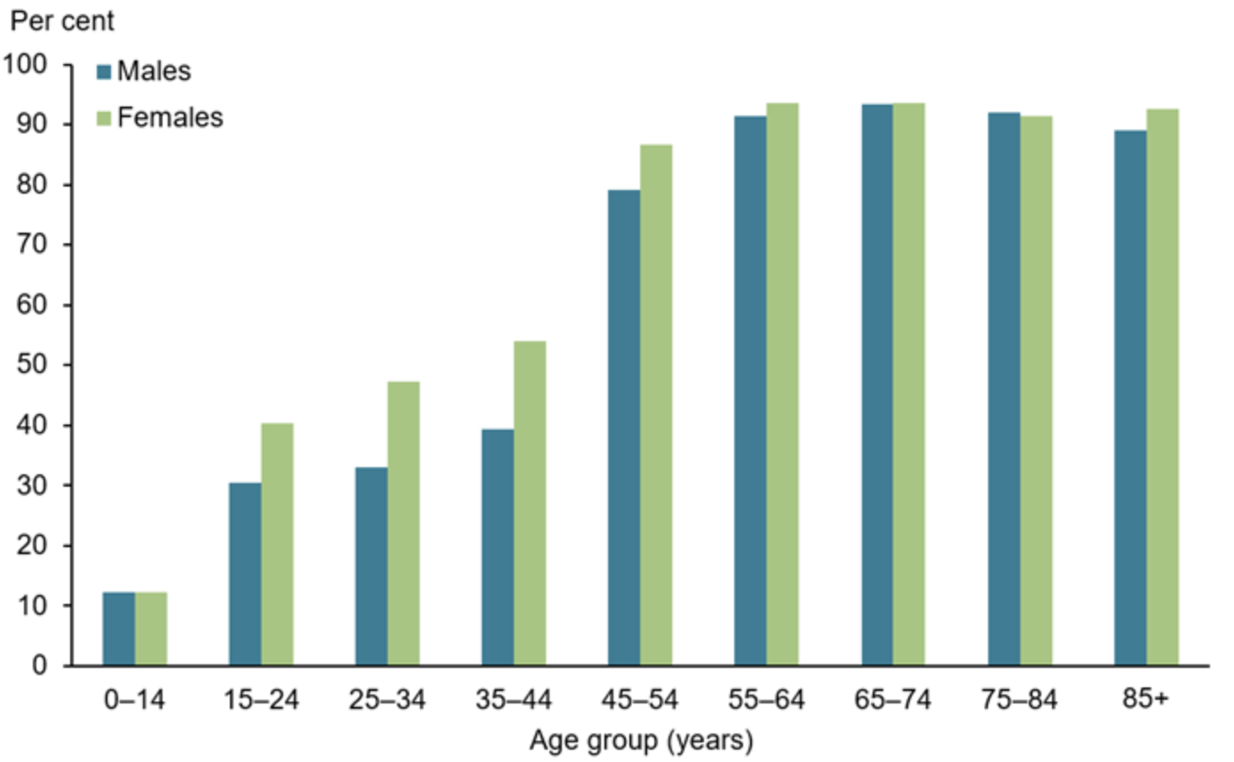
Motivation
Information availability
Image acquisition
Steep curve of eye problems
Conventional diagnosis methods
Cognitive Technologies

Slide 5
Objectives
To reduce the Diagnosis time
To reduce the Misdiagnosis Errors
To improvise performance of conventional diagnosis methods
To design a User interface for collecting patient data

Slide 6
Challenges
Diagnostic Accuracy
Integration of Portals connecting doctors and patients
Timing Entries of eye image acquisitions
Retain Error free data and Storage

Slide 7
Scope
Utilised to distinguish the symptoms of the patient who is experiencing with no immediate cooperation from specialists
Productive Feedback from the specialists
Endorsing the right medication and treatment
To make use of data for testing and training for students to be professionals

Slide 8
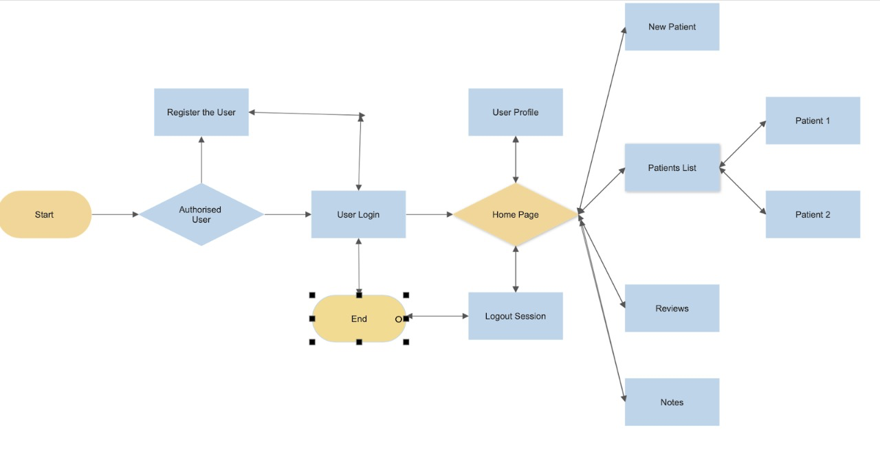
Prototype

Slide 9
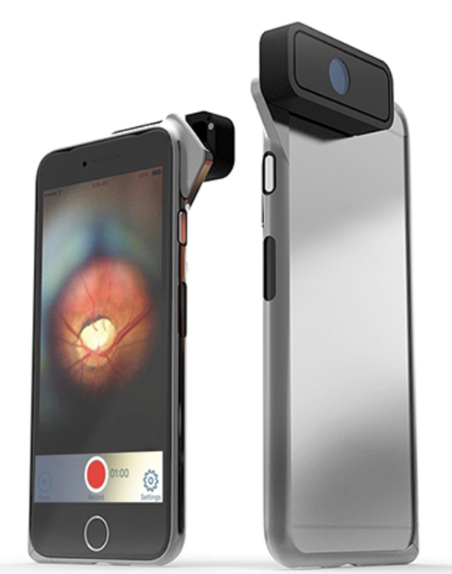
Literature Survey
Image Acquisition and Techniques to Perform Image Acquisition by
Vikas Kumar Mishra, Shobhit Kumar and Neeraj Shukla
Proposed an Image Acquisitional Models can be used to design IOT
devices
Integrating Ophthalmology and Machine Learning Algorithms
D-Eye :-
UllmanIndirect
Eye Examination
Eyecare - Ampler Grid Eye Test

Slide 10
Paper 2
Intelligent data analysis for medical diagnosis: Using machine learning by Nada Lavra, Igor Kononenko, Elpida Keravnou, Matjaz Kukar and Blaz Zupan
Extensive amounts of knowledge and data stored in medical databases request the development of specialized tools for storing and accessing of data, data analysis, and effective use of stored knowledge and data. This paper focuses on methods and tools for intelligent data analysis, aimed at narrowing the increasing gap between data gathering and data comprehension. Machine learning system to be useful in solving medical diagnostic problems.

Slide 11
Paper 3
Image processing in bio-medical area by Isuru Suranga Wijesinghe, Jayaruwan Mannapperuma, Chamath kumarasinghe, Dhananji Liyanage
Analyse the image
Process the image
Collecting error free data
Storing the data
Verifying the images
Helps to improvise the treatment

Slide 12
Paper 4
Quantitative Measurement of Eyestrain on 3d stereoscopic Display Considering the Eye foveation Model and edge information by Hwan Heo, Won Oh Lee, Kwang Yong Shin, Kang Ryoung park
Eye following alludes to the way toward estimating where we look,otherwise called our place of look.These estimations are done by an eye tracker,that records the situation of the eyes and developments they make.
Here we can place the camera lens on the retina for capturing the eye images in different angles.
The focal point of the eye is followed according to the situation of the corneal reflection.
This relative separation between the two zones permits the count of the heading of the look.

Slide 13
Screen -Based Eye Capturing through Glasses
There are two chief sorts: screen-based and glasses.
They are utilized across assortment of fields and research zones.
Here we using the cell phones are fitted close to the eyes and permit respondents to move openly.

Slide 14
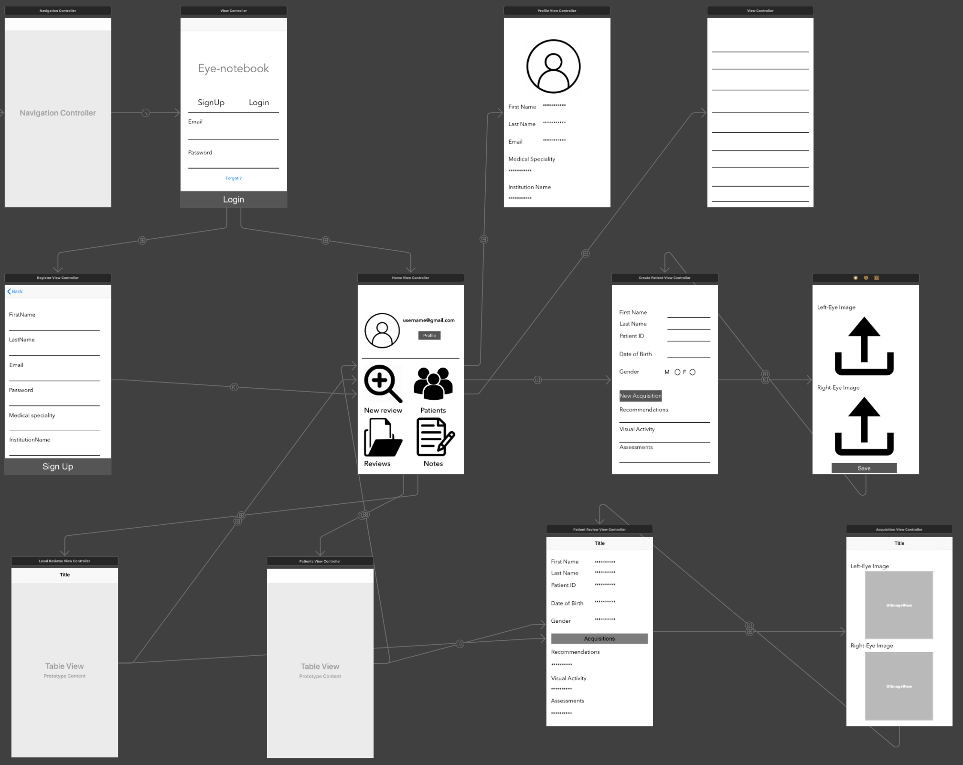
Prototype Design

Slide 15
Methodology
● At first the Organisation is needed to hold and maintain the database to store the Eye specific data along with the respective Image Acquisitions
● From the corresponding domain the doctors or medical professionals are needed to register and login with their credentials
● The application allows to provide the doctor information and his/her profile details of their qualifications and domains.
● For an individual the application allows to add the basic and generic information that is necessary for further go and list the patient on to the patient list of the corresponding doctor.
·

Slide 16
● After entering information, the application provides the feature that allows the doctor to add the image acquisition of the Eye (left eye, right eye) along with the information that is provided.
● The acquisitions along with the corresponding data that will upload to the central database that is maintained by the respective organisation.
● The data with the provided information is used for further analysis to get knowledge and to provide solutions based on the respective cause.
● The data that is stored is also used to improvise the existing solutions and can be organised and examine to extract the knowledge.

Slide 17
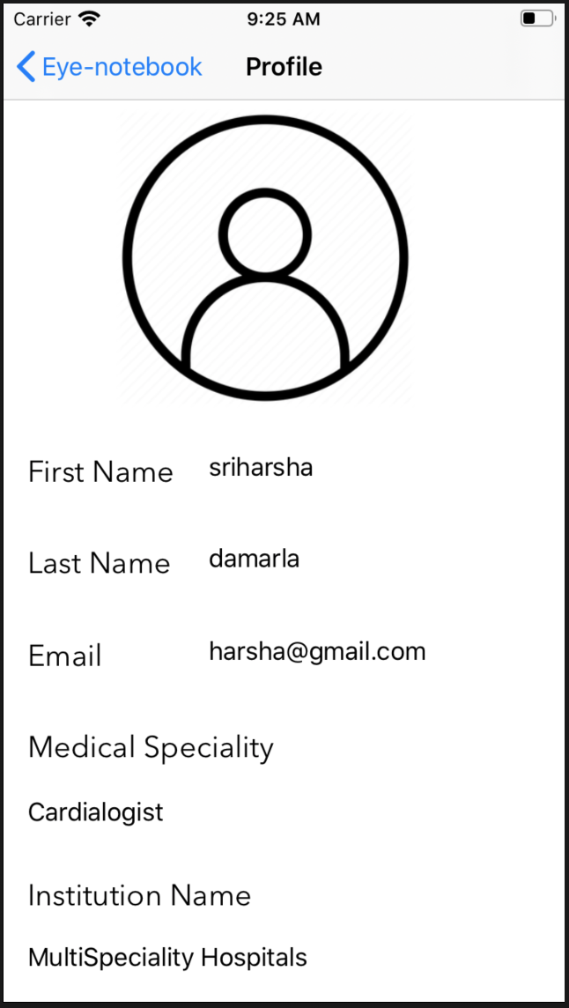
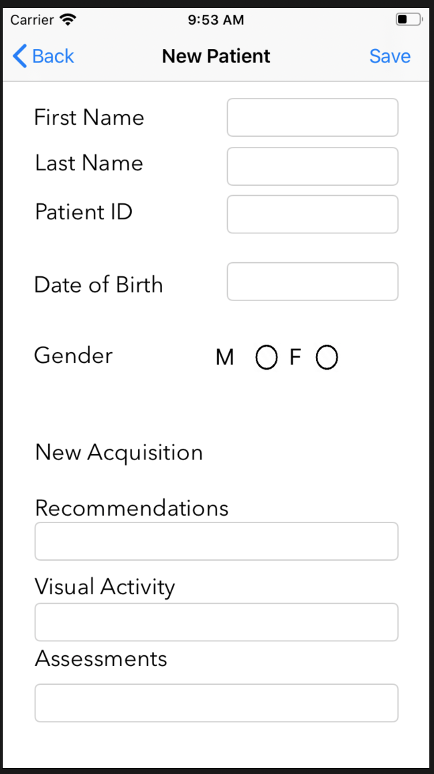
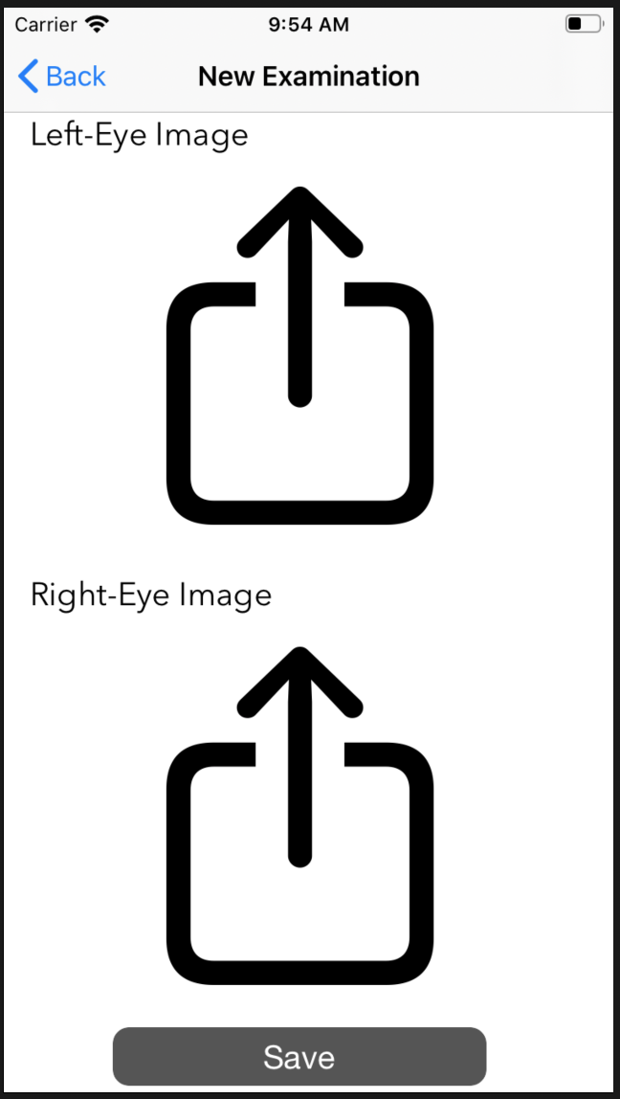
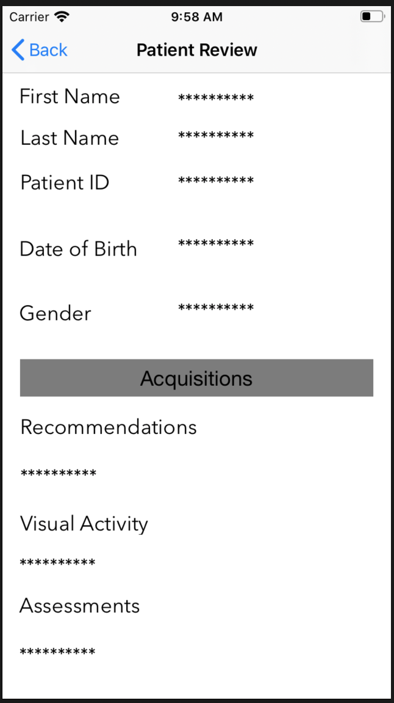
Implementation:
.

Slide 18
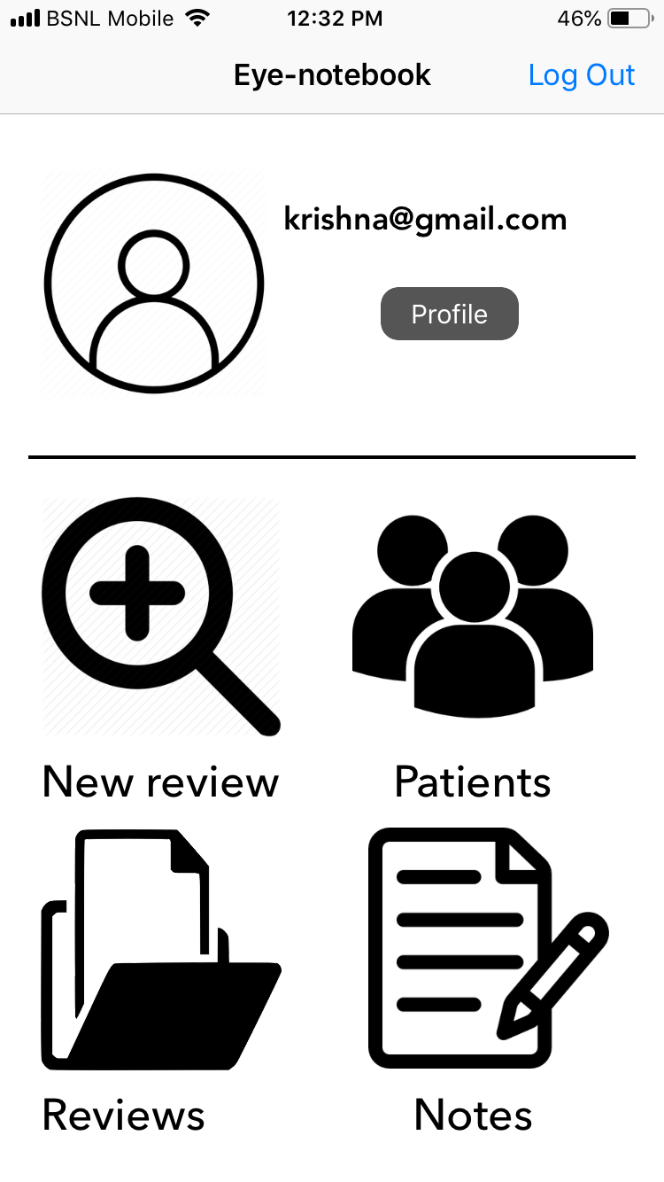
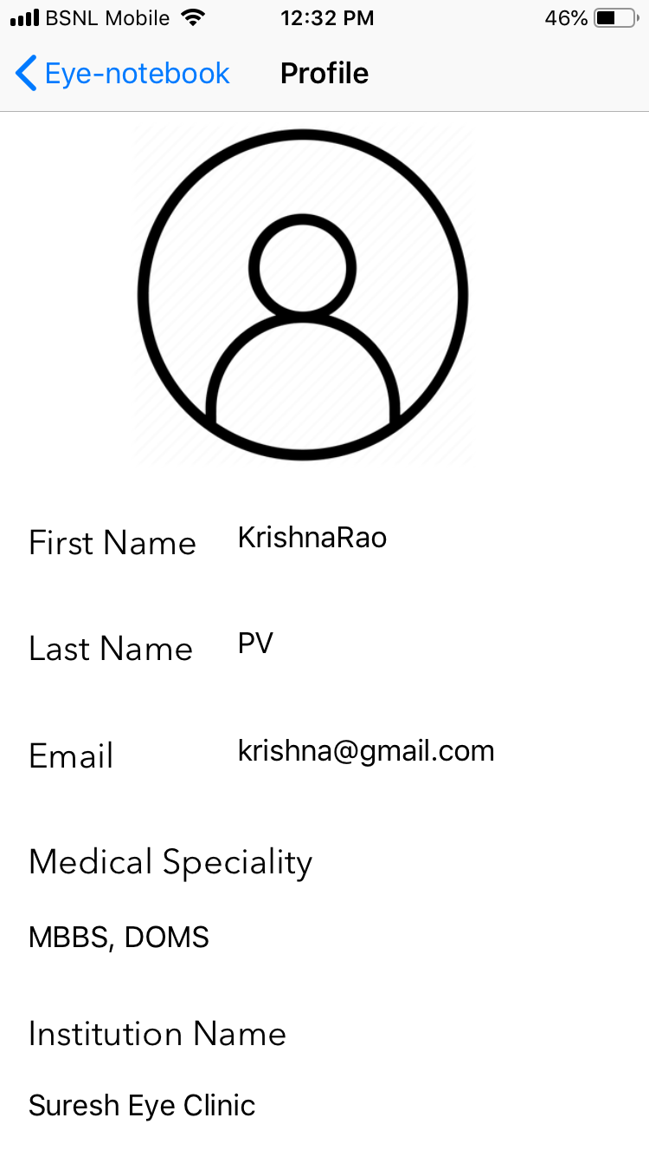
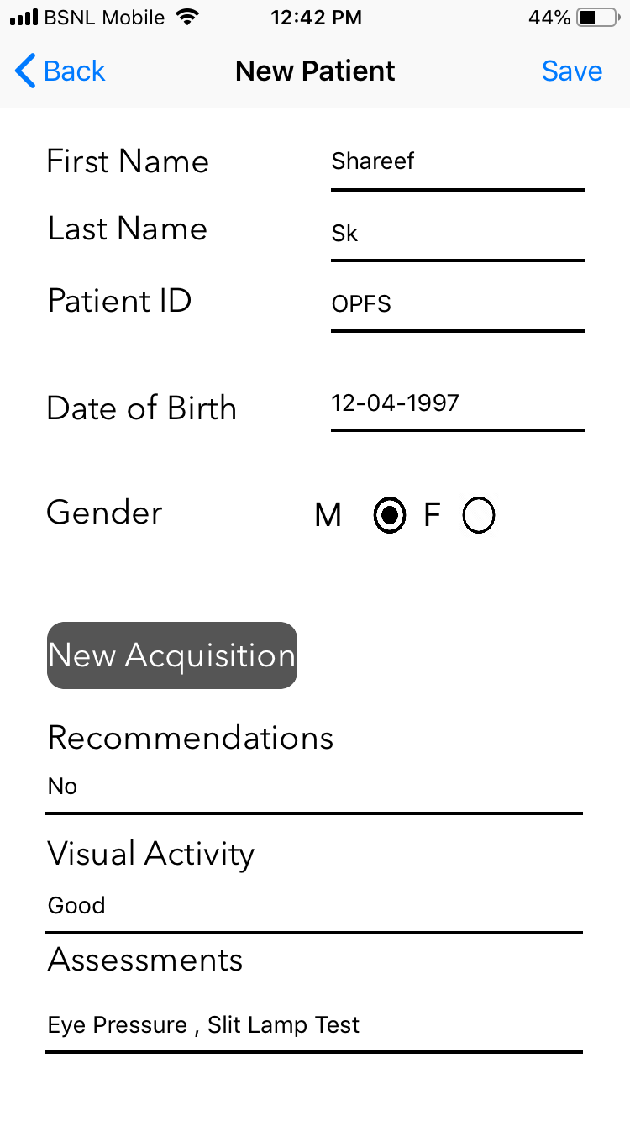
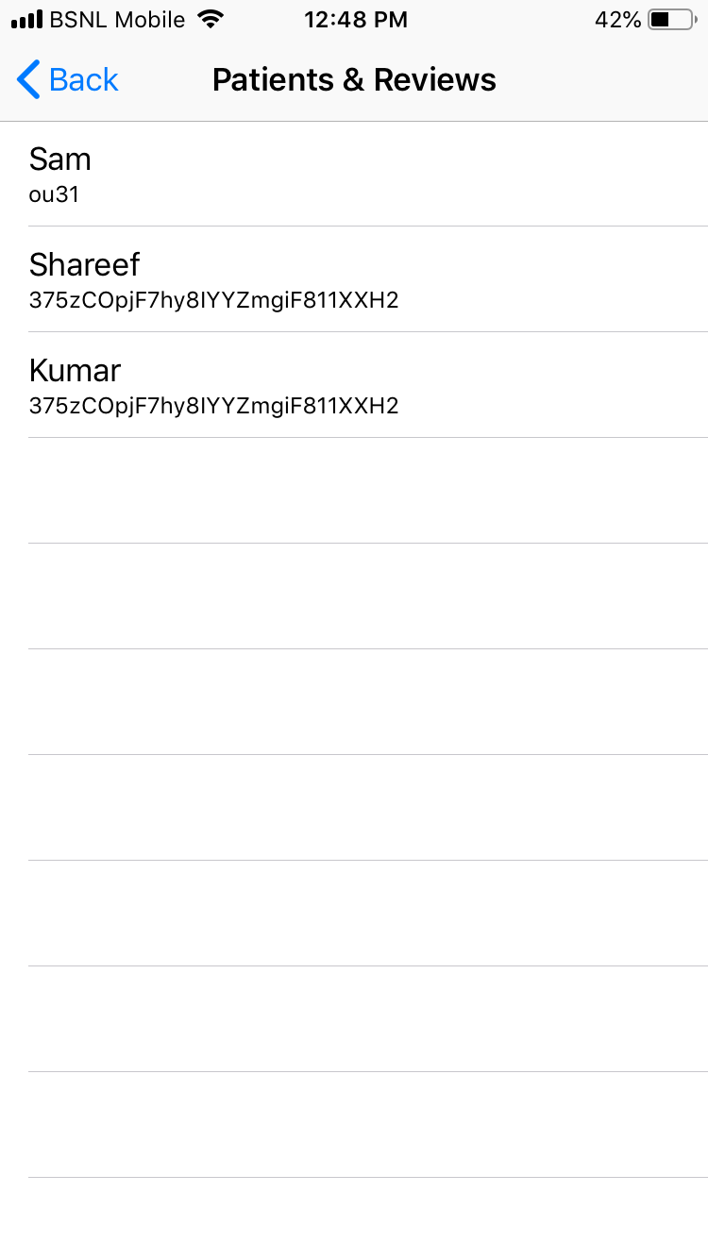
Test cases:

Slide 19
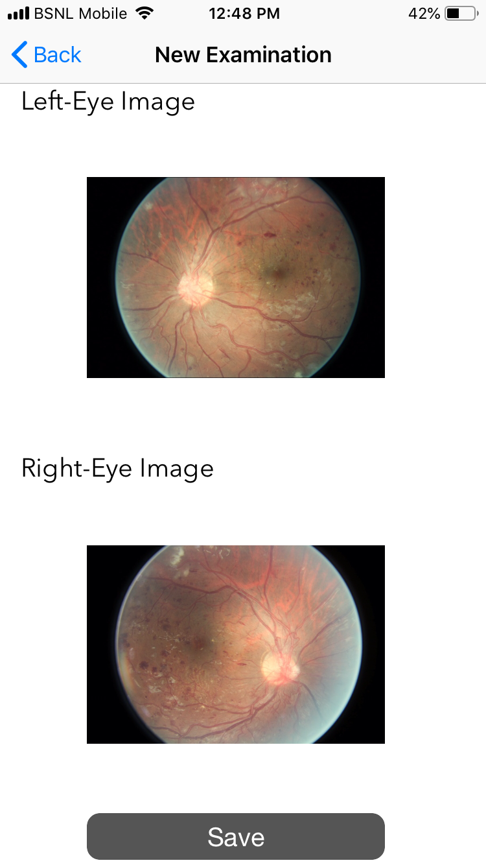
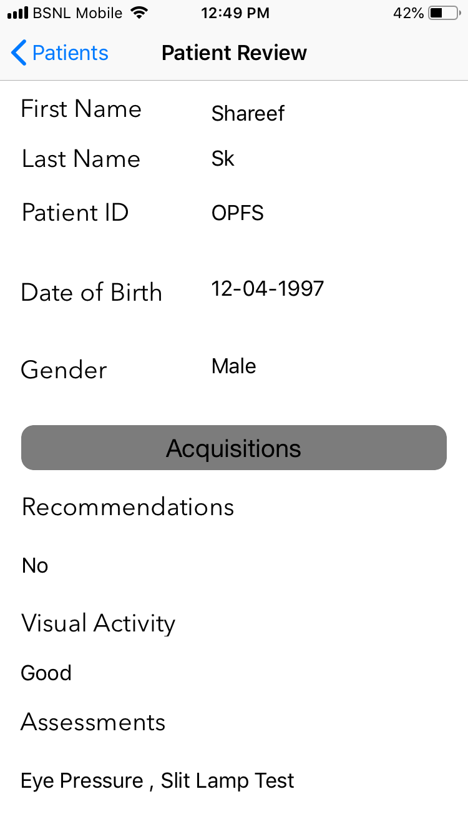
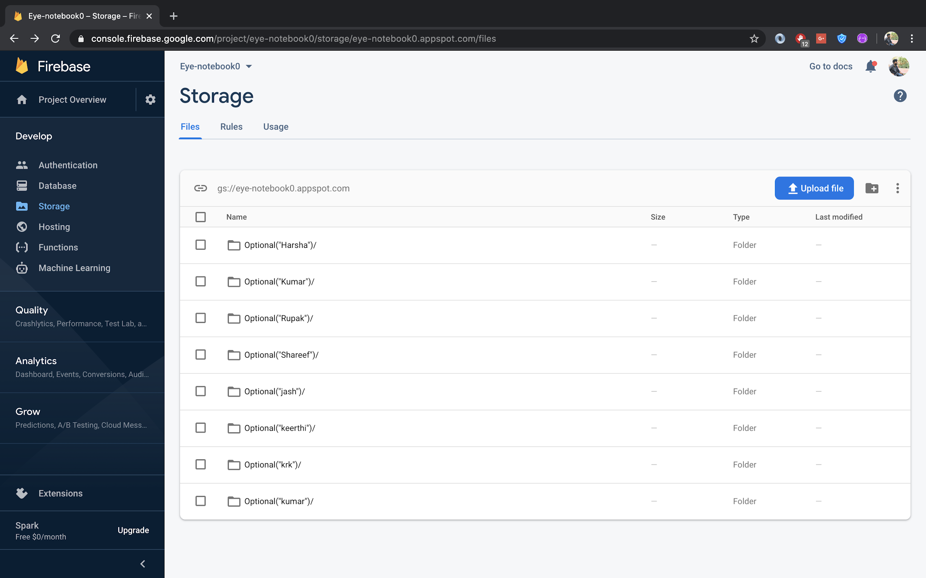
.
.

Slide 20
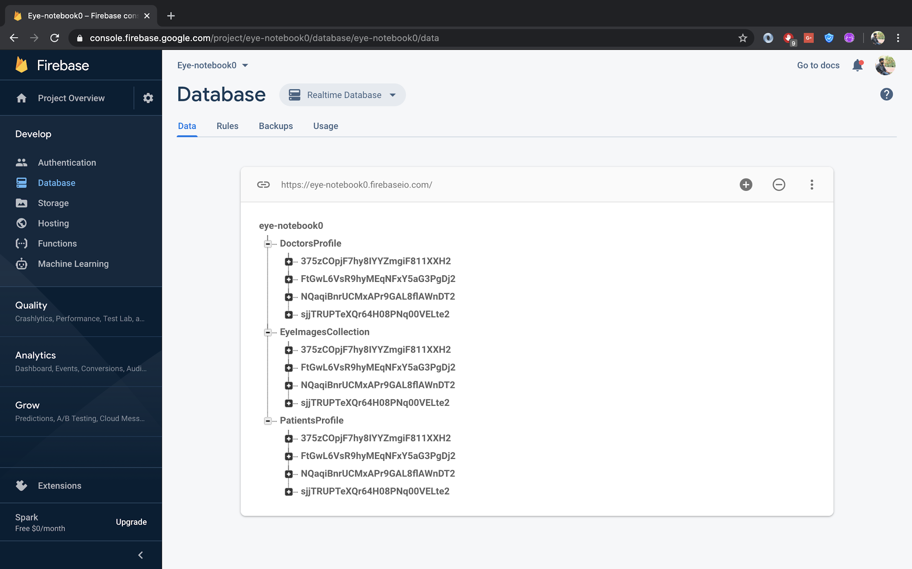
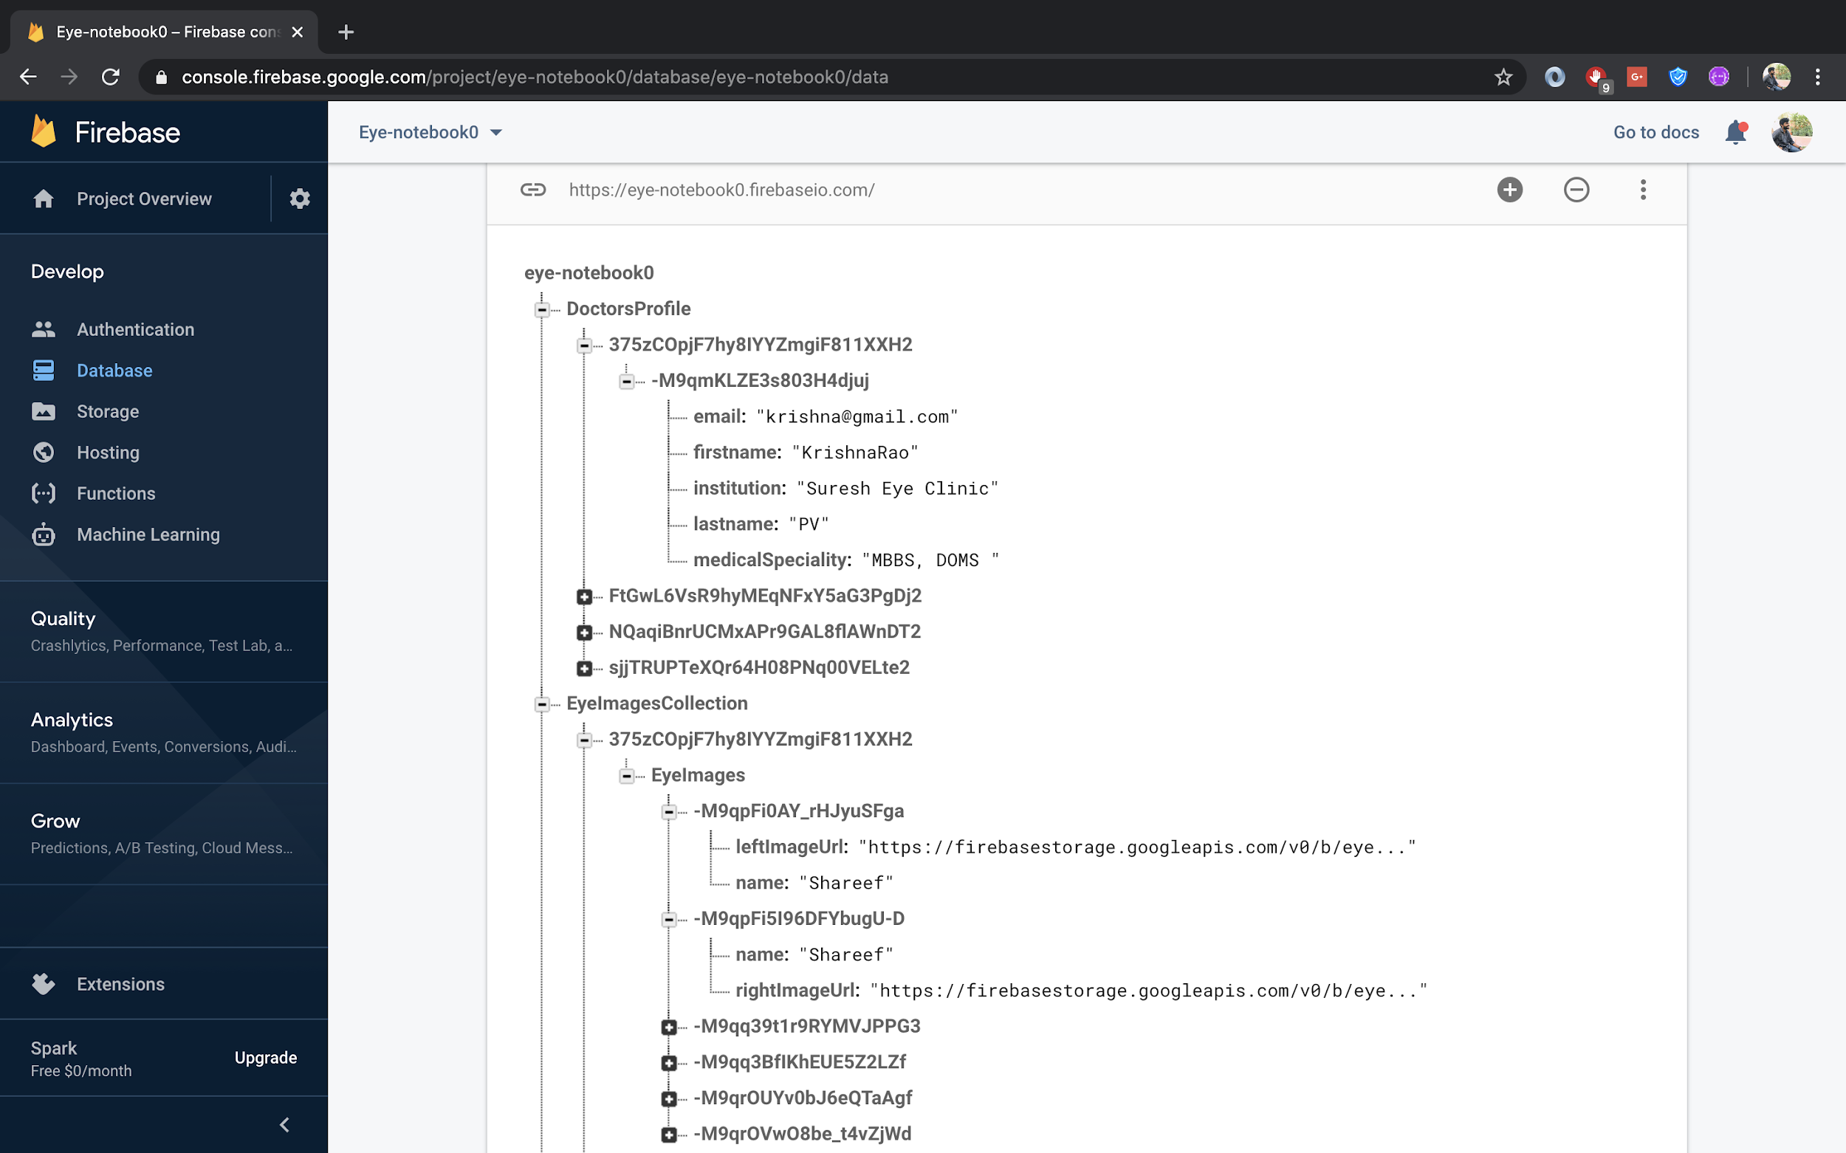

Slide 21
Advantages :
Knowledge is shared
Misconceptions are reduced
Decision making can be accurate
Analysing the condition

Slide 22
Result and Analysis
Gathering and maintaining the data.
Data accumulated is used for doctor’s reference and the research.
It makes the treatment easy.
It helps the organization for the future reference.
The data in the database is used as a reference for the students who are pursuing in this field.

Slide 23
CONCLUSION AND FUTURE WORK
A typical software is installed on a powerful computer i.e ML Server which can be accessed through internet.
Collecting data from various data sources like hospitals,physical diagnosis,localised patients.
The input data is uploaded into the ML Server and it is stored in a corresponding structure format.
Depending on the complexity of the data analysis and processing speed of the server the data is been classified.
The analysed patient data based on multiple parameters and clinical data is displayed with progress of what’s the occurrence of diseases and symptoms.

Slide 24
CONCLUSION AND FUTURE WORK
Based on the regular basis examining on the patient data to facilitate auto-prediction is done.
The output can be accessed via internet and redirecting the data to the corresponding specialised doctors.
Precautions are provided to the patient to avoid suspected cause.
Ophthalmologists should know about the AI and Machine Learning resources available to them to improvise their knowledge.

Slide 25
References
Image Acquisition and Techniques to Perform Image Acquisition Article in SAMRIDDHI A Journal of Physical Sciences Engineering and Technology · July 2017 DOI: 10.18090/samriddhi.v9i01.8333
Caixinha M.,Nunes S. Machine learning techniques in clinical vision sciences.Current Eye Research. 2017;42(1):1-15.doi: 10.1080/02713683.2016.1175019.
Machine Learning Has Arrived! Lee A, Taylor P, Kalpathy-Cramer J, Tufail A Ophthalmology.2017 Dec;124(12):1726-1728.
Catania L. J., Nicolitz E. Artificial intelligence and its applications in vision and eyecare.

Slide 26
References
Advances in Ophthalmology and Optometry.2018;3(1):21-38.doi:10.1016/j.yaoo.2018.04.001.
Case study research in information systems, Graeme Shanks, Nargiza Bekmamedova,in Research Methods (Second Edition), 2018.
Data Driven Approach for Eye Disease Classification with Machine learning.c Sadiq ,Irfan Karamat and Martin Fleury, Received: 21 May 2019;Accepted: 8 july 2019; Published: 11 July 2019
Batchelor B.G., Foot G.E. (1988) Image Acquisition and Processing techniques for Industrial Inspection. In: Turksen I.B., Asai K., Ulu

Slide 27

.

